Slide 1
The posse
Solomon Newton
Desmond Wallace
Hadi Saeed
Ammar Alnaqeeb
Lucas Stan

Slide 2
BlackJack Game Rules
Dealer deals 2 cards to the player including self. One of the dealer’s card is face down.
Player plays until card reaches or close to 21. If cards exceeds 21 , player bust an dealer wins .
If player’s hand does not reach 21, player can choose to hit or stand.
If player bust, player pays dealer else dealer pays player 2x player’s money.
If player ties with the dealer, player get to keep money.
Ace can be either 1 or 11, at the player’s convenience.
The house always wins if they have 21.

Slide 3
PSEUDOCODE FOR THE BLACK JACK GAME
Input / Output and Subtasks
- Ask player to hit ‘Enter’ to Start the Game -Player press the ‘enter’ key to start game
- computer deals out two random cards from
the deck to player and displays both cards
(Card1 and Card2) along with the cardTotal =
Card1 + Card2 -Player can choose to either “HIT” or “STAY” and press Enter to confirm
-ask Player if they would like to “HIT” or “STAY” -Player can choose to either “HIT” or “STAY” and press Enter to confirm
-If the player chooses to “HIT”, present player

Slide 4
with new card (card3) and new cardTotal =
cardTotal + card3
If the new cardTotal > 21 advise the player
“BUSTED”
-If player chooses to “STAY” display cardTotal
and advise if “Winner” or “Bust”
If cardTotal > 21 = “BUSTED”
If cardTotal =< 21 = “WINNER”
-Ask Player if they would like to “HIT” or
“STAY”
-if the player chooses to “HIT”, present player
with a new card (card4) and new cardTotal =
cardTotal + card4
-display cardTotal and advise if “Winner” or
“Bust”
If cardTotal > 21 = “BUSTED”
If cardTotal =< 21 = “WINNER”
Display if Player is “WINNER” or “BUSTED”
End Game;

Slide 5
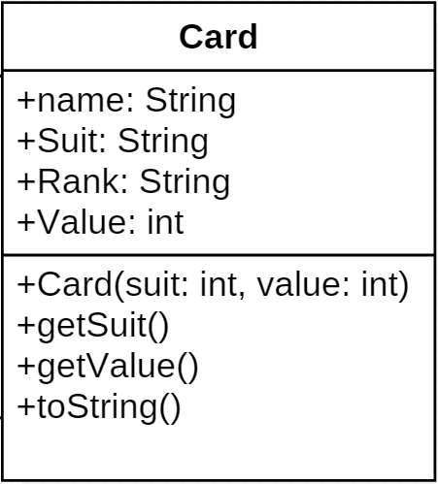
The card class diagram

Slide 6
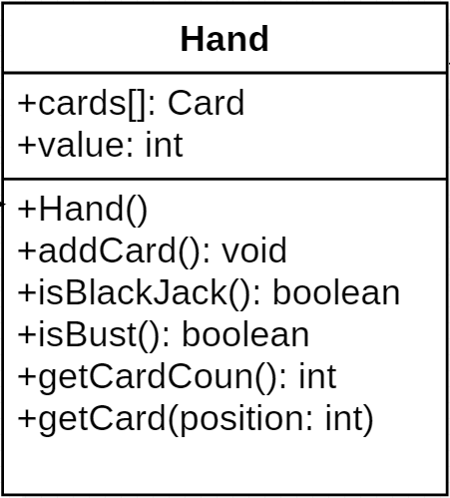
The hand class diagram

Slide 7
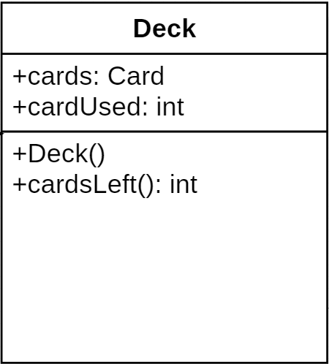
The deck class diagram

Slide 8
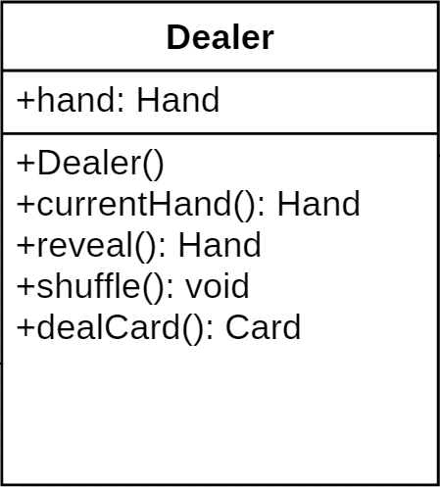
The dealer class diagram

Slide 9
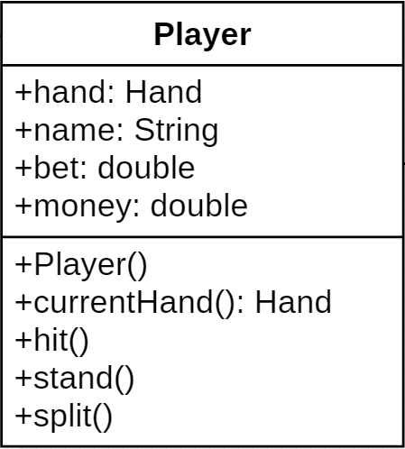
The player class diagram

Slide 10
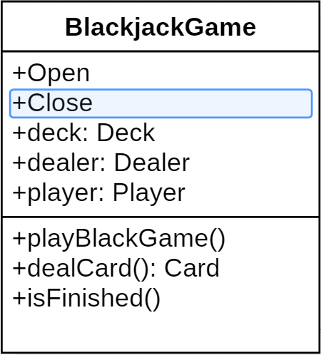
BlackJack class diagram

Slide 11
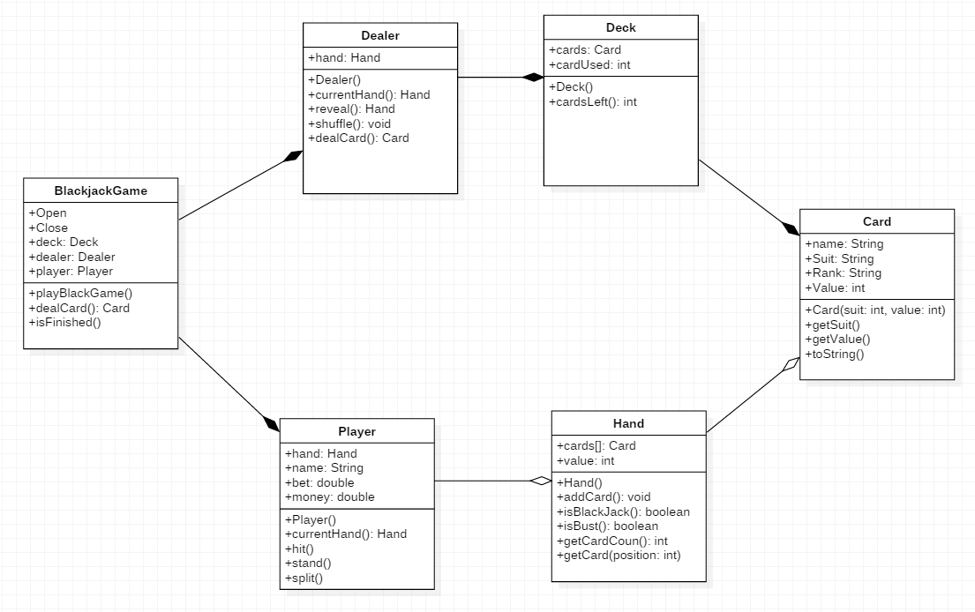
The complete UML class diagram

